Slide 1
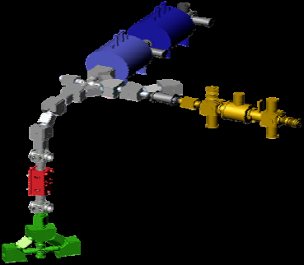
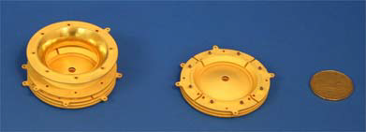
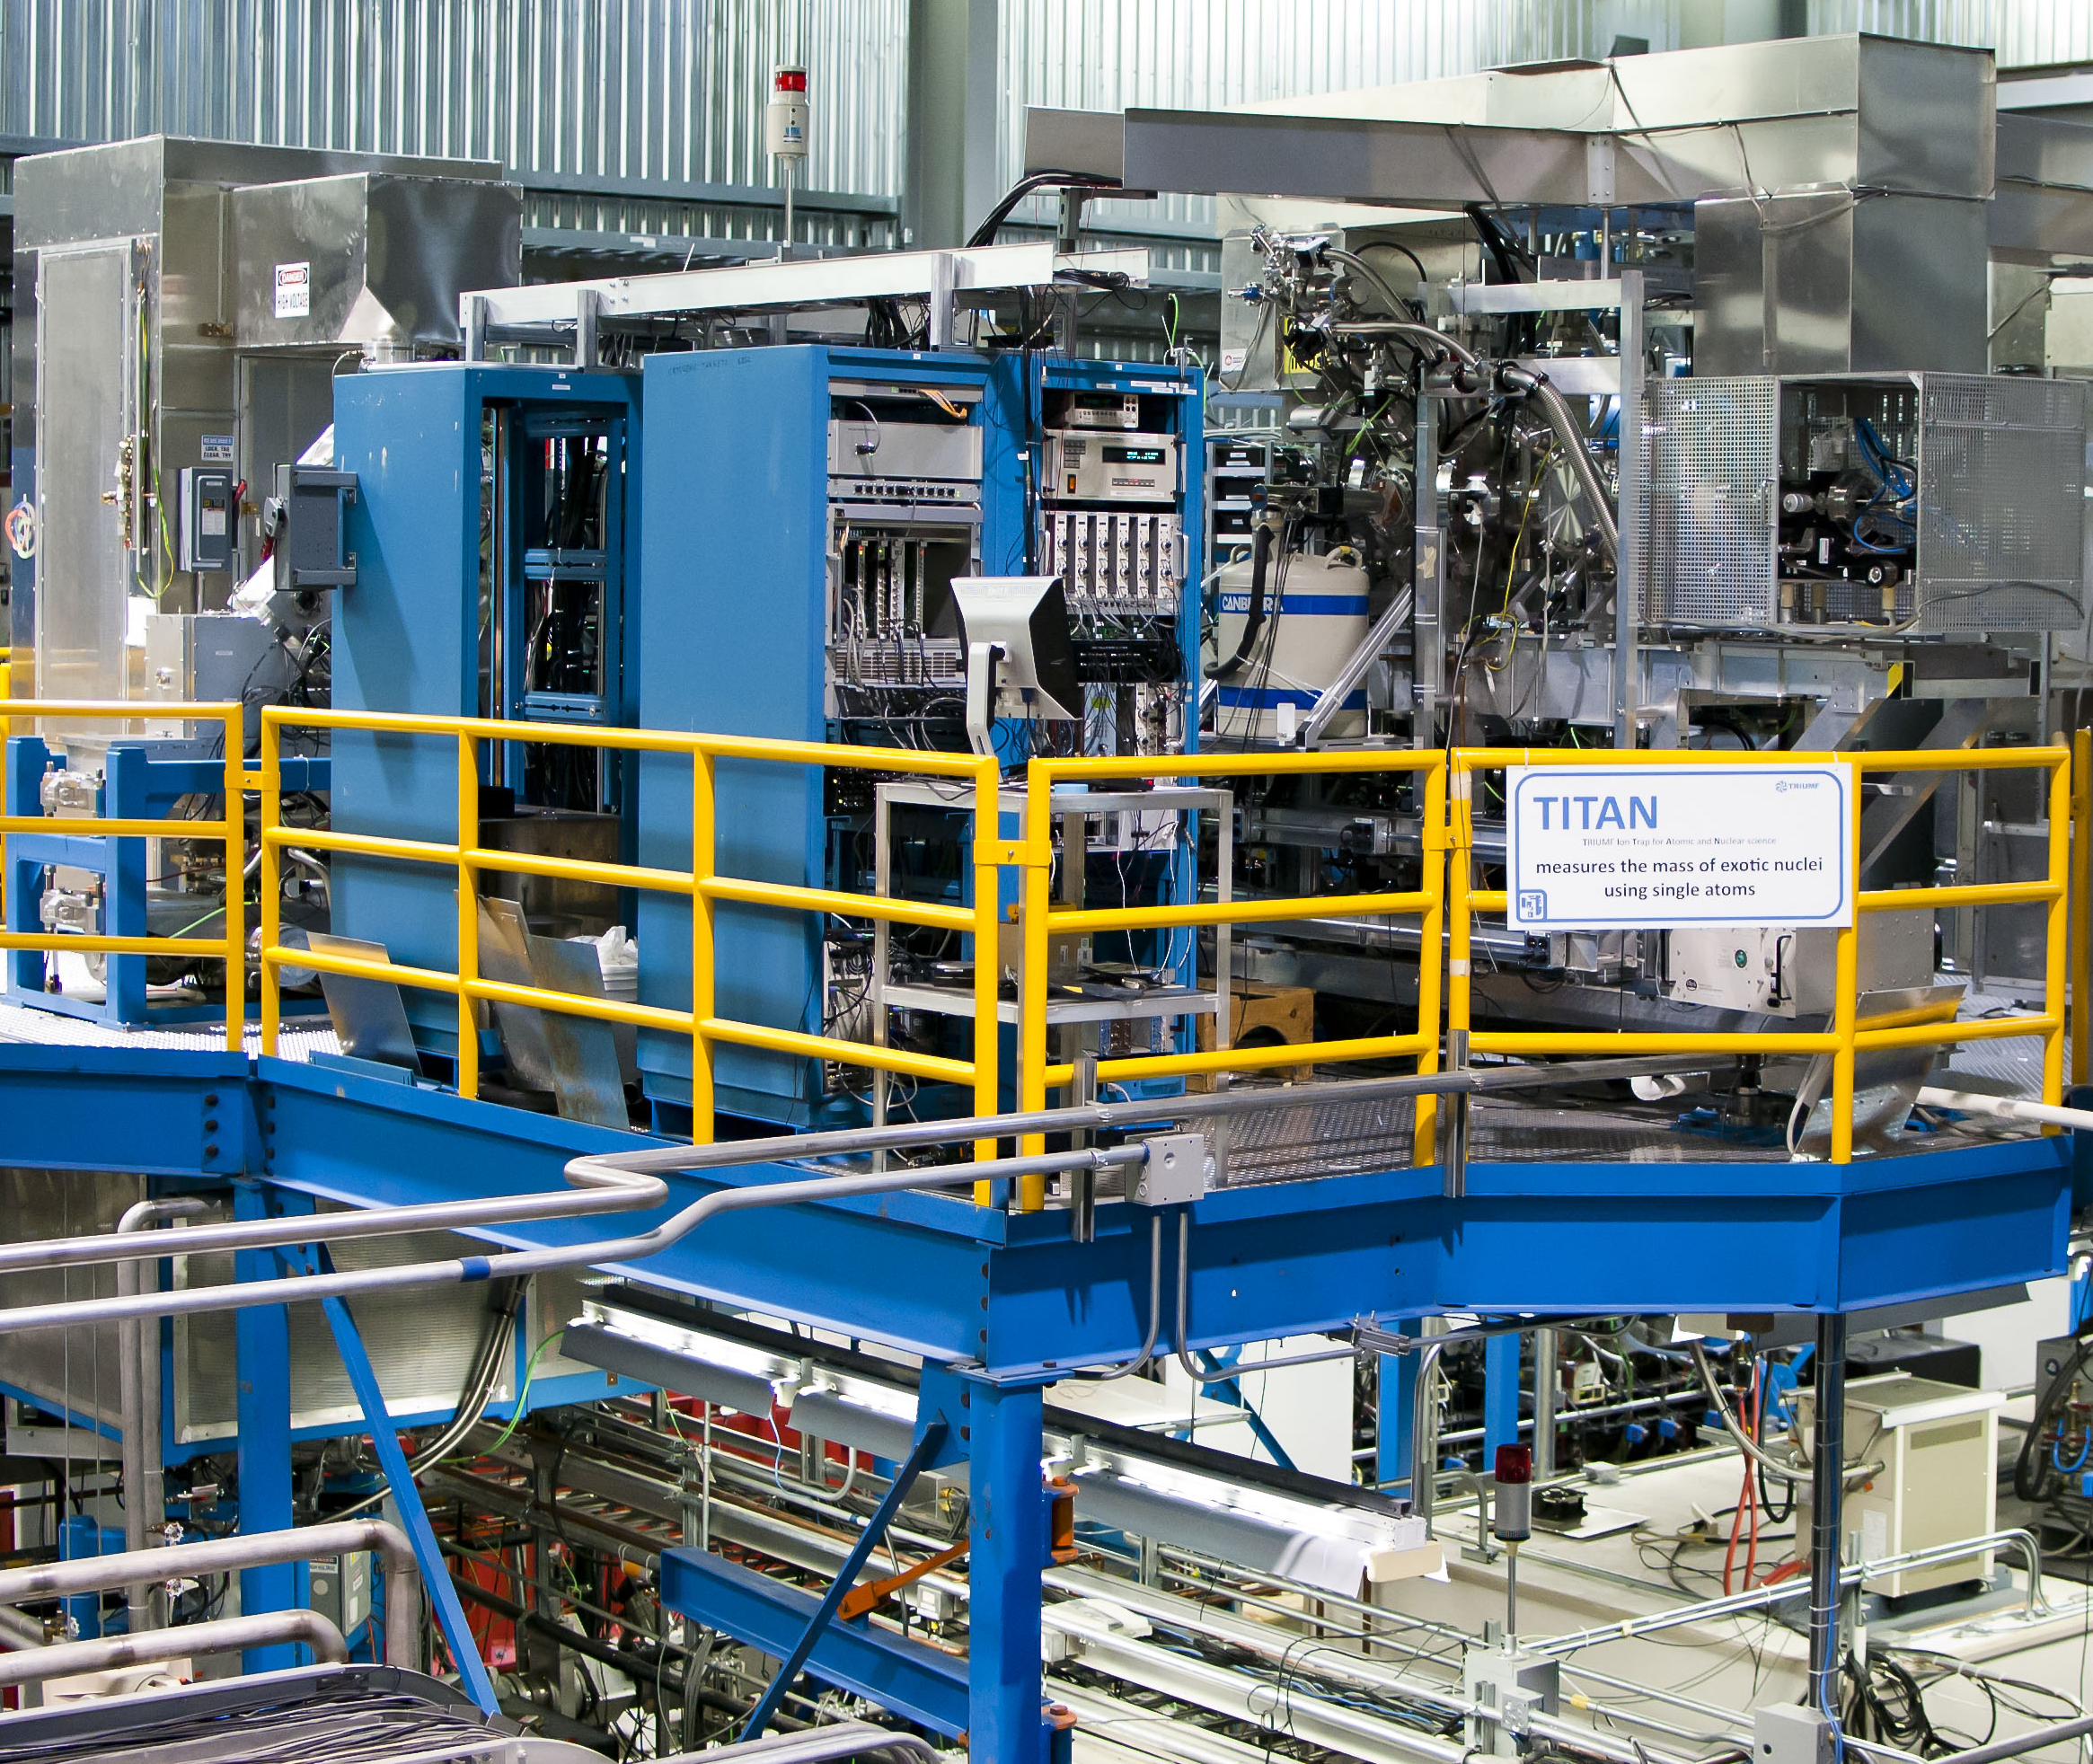
Penning Trap Mass Measurements at TITAN
April 19, 2017
American University Physics Seminar
D. Lascar | Postdoctoral Fellow | TRIUMF

Slide 2
Precision v. Accuracy
x
x
x
x
x
x
x
x
x
x
x
x
x
x
x
x
x
x
x
x
x
x
x
x
x
x
x
x
x
x
Not Accurate
Not Precise
Accurate
Not Precise
x
x
x
x
x
x
x
x
x
x
x
x
x
x
x
x
x
x
x
Not Accurate
Precise
Accurate
Precise

Slide 3
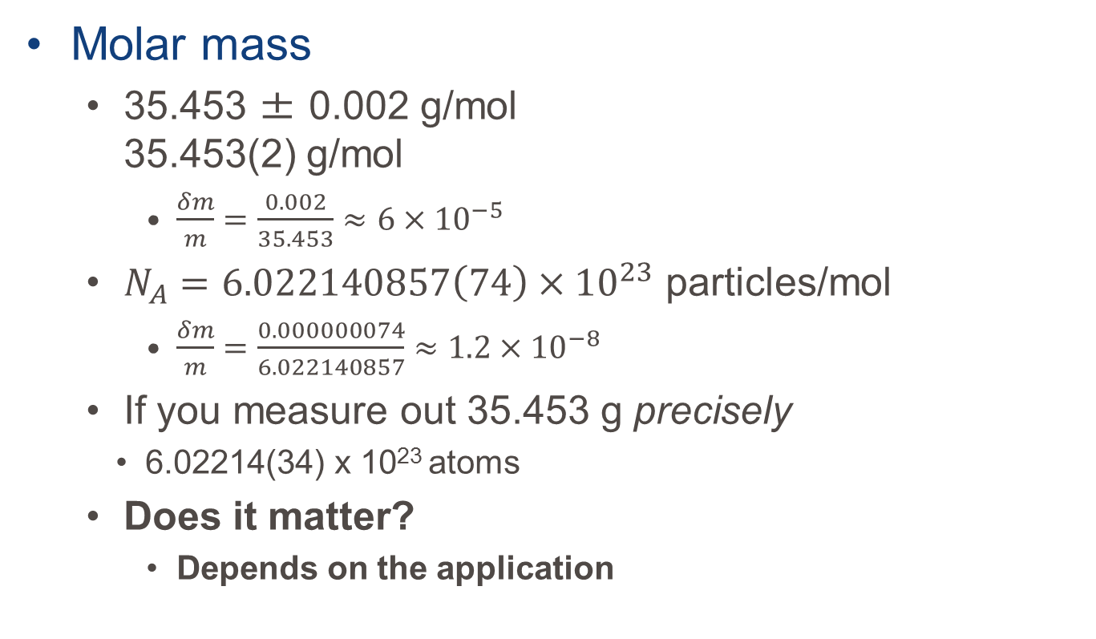
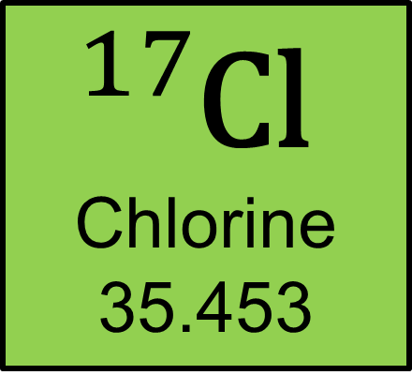
Why measure masses?
$${}_{}^{17}{\text{Cl}}$$
Chlorine
35.453
Molar mass
35.453 ± 0.002 g/mol 35.453(2) g/mol
$\frac{δm}{m}=\frac{0.002}{35.453}≈6×{10}^{−5}$
$N_{A}=6.022140857\left(74\right)×{10}^{23}$ particles/mol
$\frac{δm}{m}=\frac{0.000000074}{6.022140857}≈1.2×{10}^{−8}$
If you measure out 35.453 g precisely
6.02214(34) x 10²³ atoms
Does it matter?
Depends on the application
Notes:
Molar mass uncertainty is all that matters

Slide 4
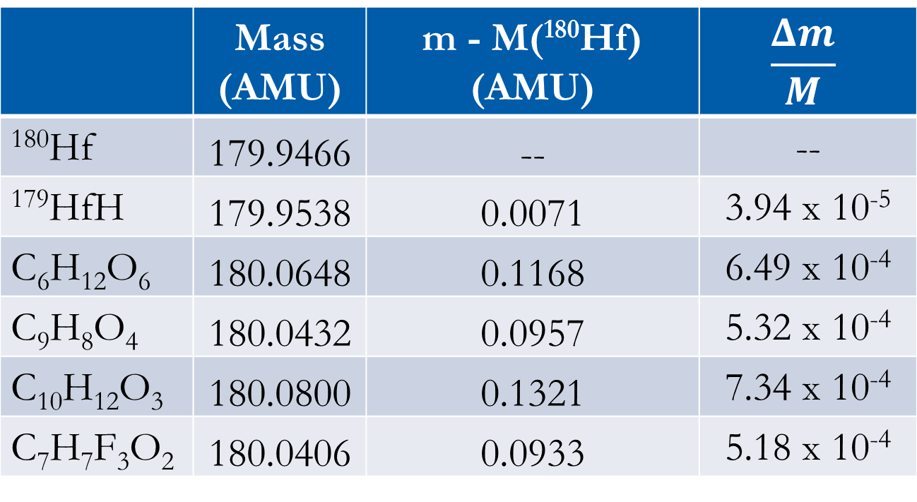
Why measure masses?
 | Mass (AMU) | m - M(¹⁸⁰Hf) (AMU) | $$\frac{Δm}{M}$$
¹⁸⁰Hf | 179.9466 | -- | --
¹⁷⁹HfH | 179.9538 | 0.0071 | 3.94 x 10⁻⁵
C₆H₁₂O₆ | 180.0648 | 0.1168 | 6.49 x 10⁻⁴
C₉H₈O₄ | 180.0432 | 0.0957 | 5.32 x 10⁻⁴
C₁₀H₁₂O₃ | 180.0800 | 0.1321 | 7.34 x 10⁻⁴
C₇H₇F₃O₂ | 180.0406 | 0.0933 | 5.18 x 10⁻⁴

Slide 5
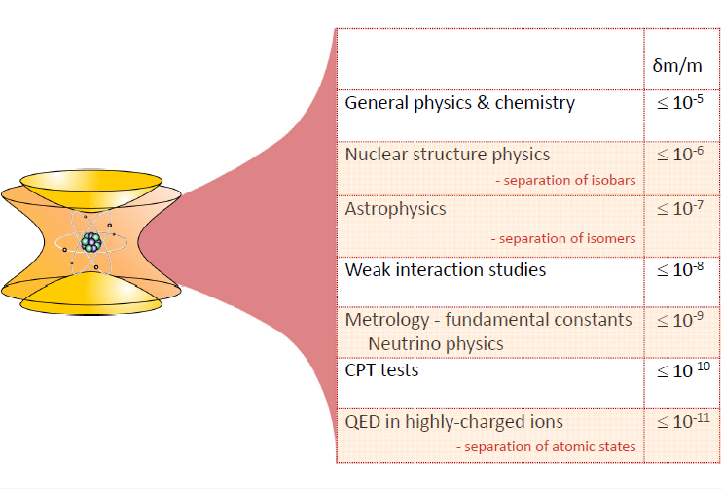
What do masses tell us?
Nuclear Masses of Rare Isotopes:
Magic numbers of exotic nuclei (new shell closures)
R-process waiting points
Inform theory
CKM matrix
Notes:
Masses used in almost every subfield of physics
Only difference is the precision required
For astrophysics that’s 10 keV/c²
For QED that’s 1eV/c²

Slide 6
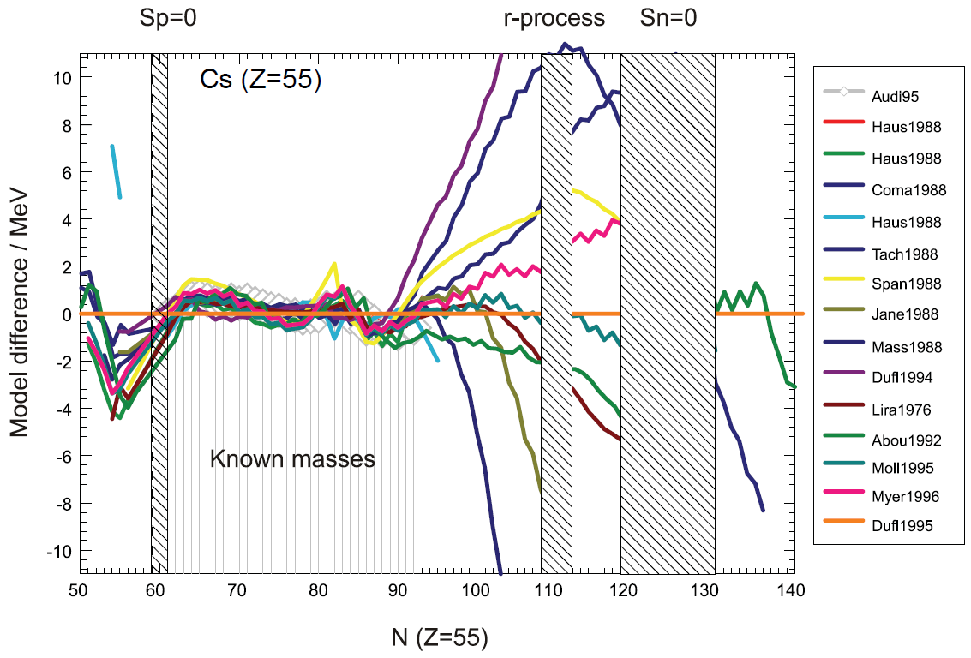
Nuclear mass models are…
Model difference (MeV)
Notes:
Clearly we need the masses of nuclei far from stability.
In the region of known masses, models are quite good but not terribly useful -> Why use a model when you have the data?

Slide 7
Nuclear mass models are…insufficient
Model difference (MeV)
Notes:
Further from stability, where the explosive astrophysical processes occur, there’s much more disagreement.
For the most part, that’s the area where I study. WHY?

Slide 8
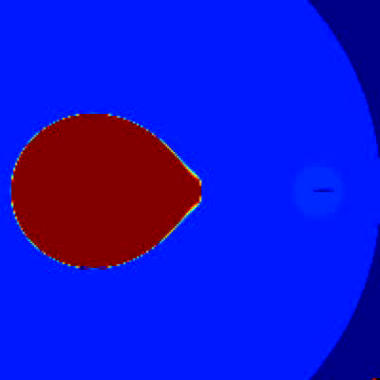
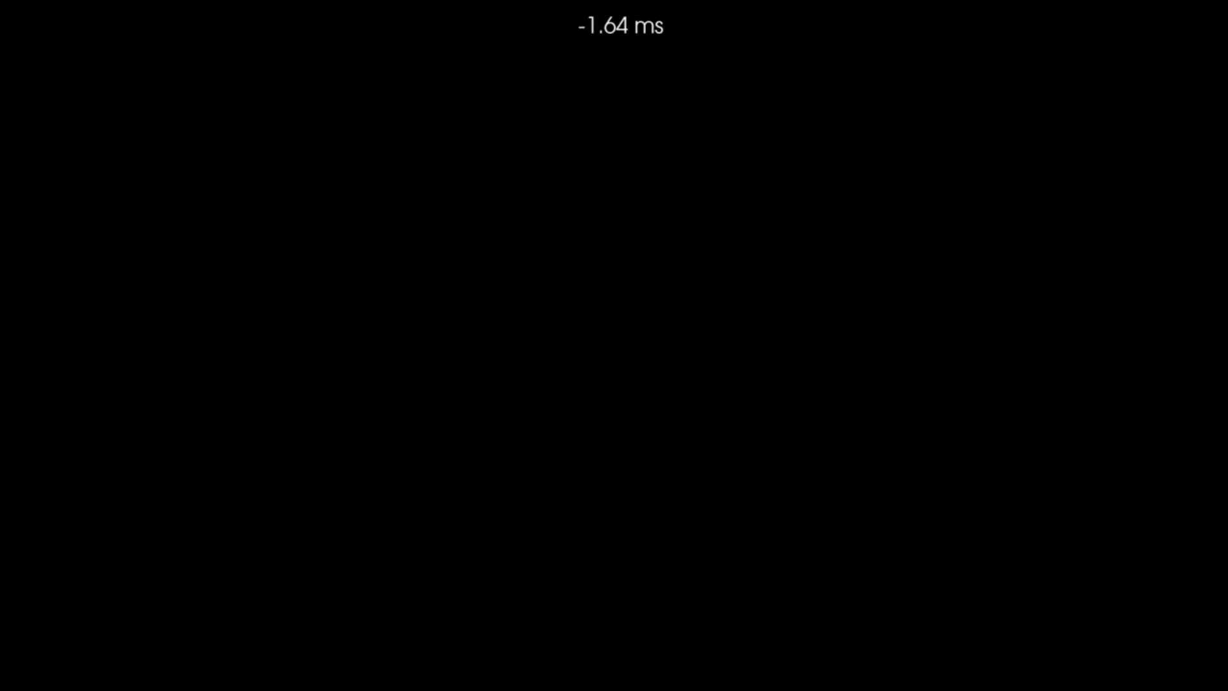
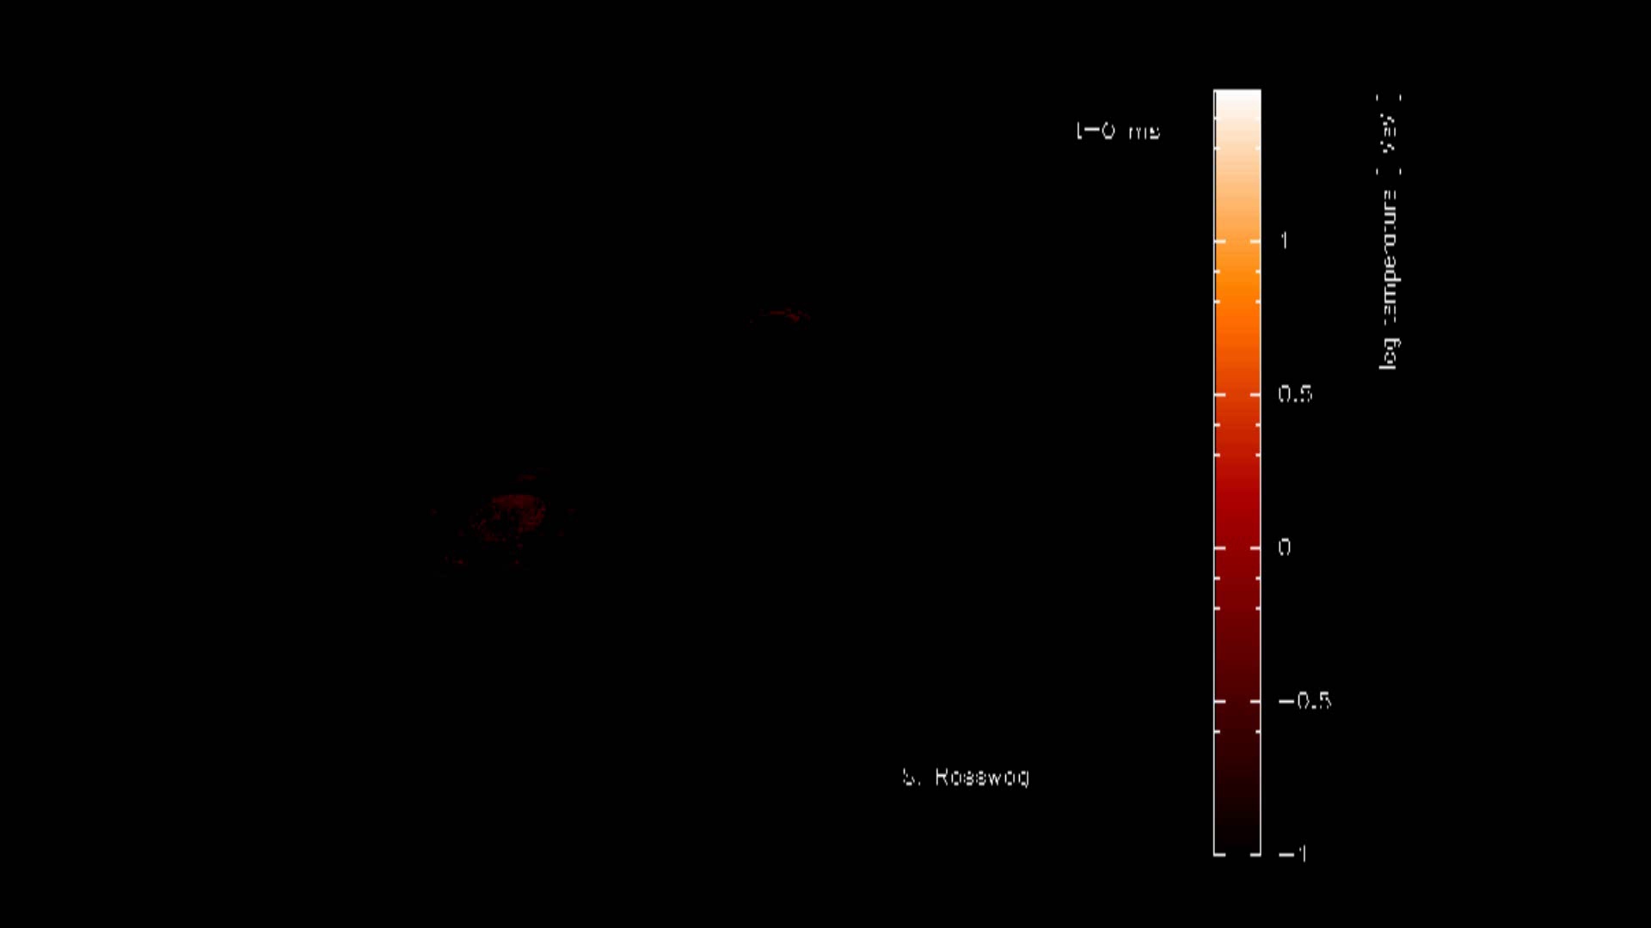
Explosive nucleosynthesis
Type-I X-ray burst
Type-II (CC) SN
Courtesy of J. Blondin NCSU
http://wonka.physics.ncsu.edu/~blondin/AAS/
C. Ott et al ApJ 768, 115 (2013)
Neutron star merger
S. Rosswog et al MNRAS 430 4 (2013)

Slide 9
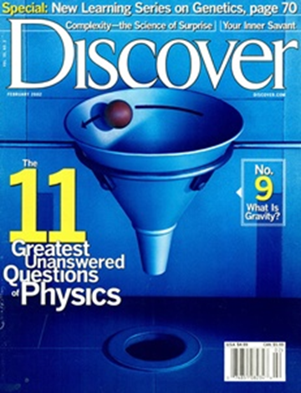
Nuclear Astrophysics
Big Bang
¹H, ²H, ³He, ⁴He, ⁶Li, ⁷Li
Cosmic Ray Spallation (interstellar medium)
Many elements, including most Li, Be, B
Stellar Burning
Up to ⁵⁶Fe
p Process (core-collapse supernovae)
Some heavy elements
rp/νp Process (x-ray bursts)
s Process (AGB stars)
Heavy elements up to A=208 (half of all heavy nuclei)
r Process (??)
Heavy elements A>56 (the other half)
Notes:
Triple-$α$ -> $α+α=$ ⁸Be + $α$ = ¹²C
Question 3:
How were the heavy elements from iron to uranium made?
Feb. 1, 2002

Slide 10
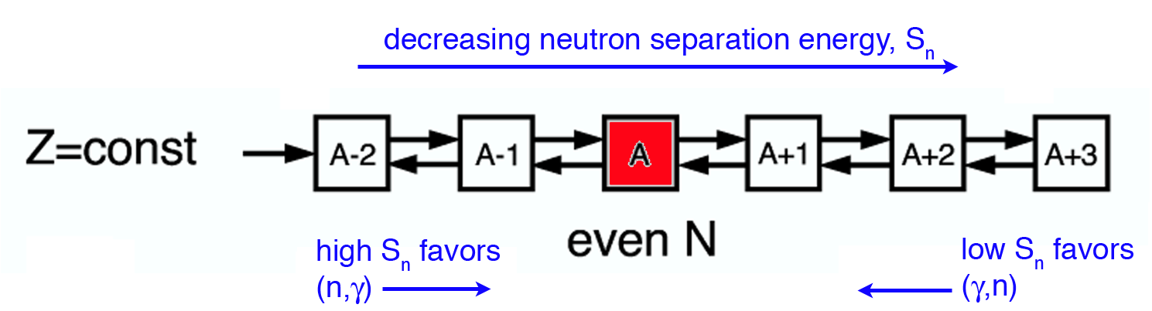
The astrophysical r-process
Temperatures are very high (T~10⁹K)
Neutron densities are very high (n_{n} > 10²⁰ cm⁻³)
(n,γ) rate is high ( < 1 μs/capture )
As region of low neutron separation energy (S_{n}) reached (n,γ) ↔ (γ,n) equilibrium achieved
[A. Champagne, RIA Summer School ‘06]
Notes:
As Sn drops, the number of available photons with enough energy knock out a neutron increase.

Slide 11
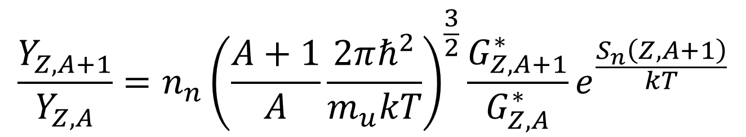
The astrophysical r-process
Temperatures are very high (T~10⁹K)
Neutron densities are very high (n_{n} > 10²⁰ cm⁻³)
(n,γ) rate is high ( < 1 μs/capture )
As region of low neutron separation energy (S_{n}) reached (n,γ) <-> (γ,n) equilibrium achieved
Equilibrium point defined by Saha Equation
Neutron separation energy
$$\frac{Y_{Z,A+1}}{Y_{Z,A}}=n_{n}{\left(\frac{A+1}{A}\frac{2πℏ^{2}}{m_{u}kT}\right)}^{\frac{3}{2}}\frac{G_{Z,A+1}^{∗}}{G_{Z,A}^{∗}}e^{\frac{S_{n}\left(Z,A+1\right)}{kT}}$$
…
Z
Neutron density
Temperature
N
Notes:
The left size is the ratio of relative abundance between two adjacent isotopes.

Slide 12
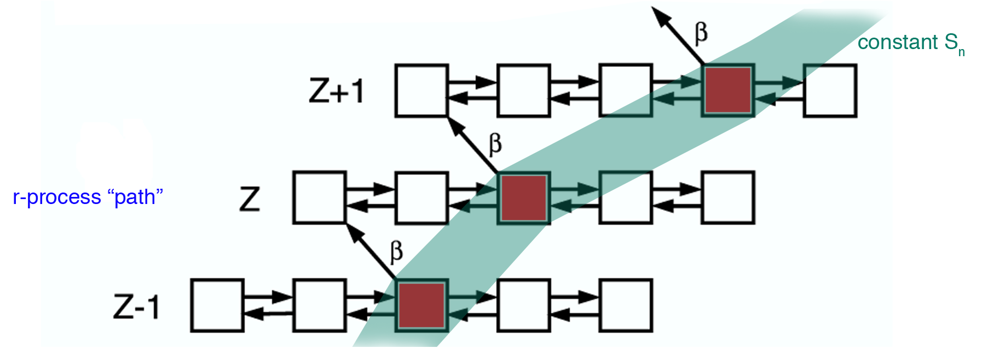
So we wait for a β-decay
[A. Champagne, RIA Summer School 06]
The S_{n} where equilibrium occurs depends only on T and n_{n}
Notes:
Walk through the process. Start with Stability and the s-process then move towards the r-process.
Note the path density at the closed shells.

Slide 13
Neutron separation energy and mass

Slide 14
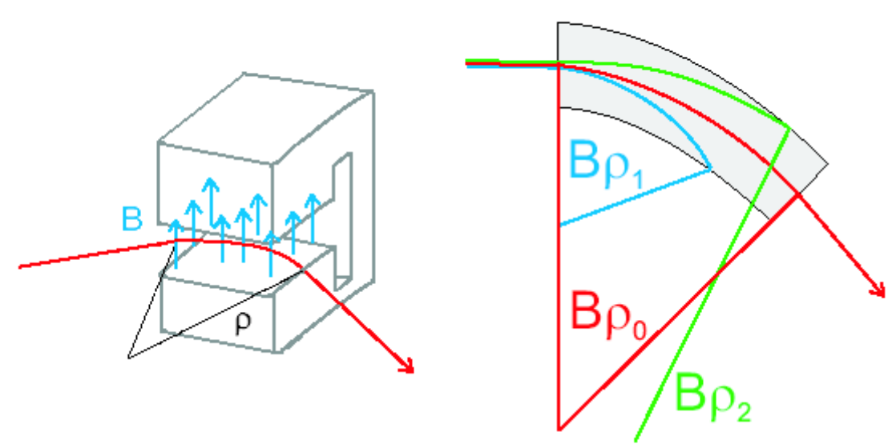
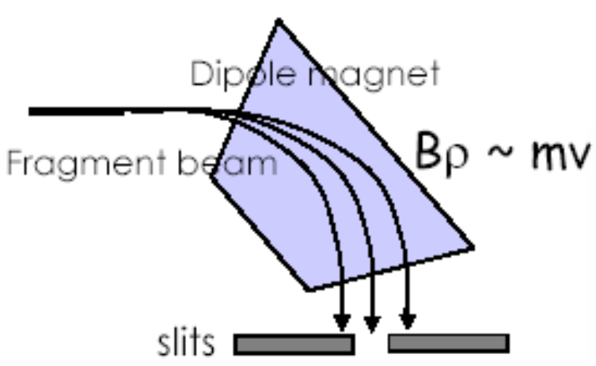
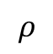
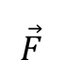
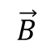
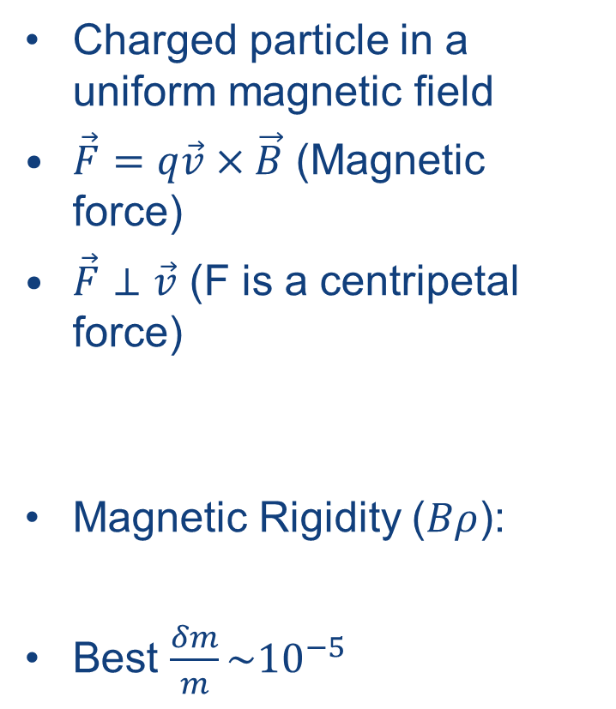
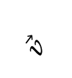
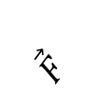
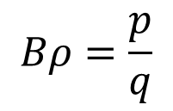
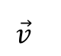
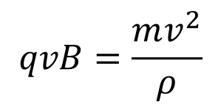
How to measure masses?
$$\vec{B}$$
Dipole mass spectrometry
$$ρ$$
$$\vec{F}$$
Charged particle in a uniform magnetic field
$\vec{F}=q\vec{v}×\vec{B}$ (Magnetic force)
$\vec{F}⊥\vec{v}$ (F is a centripetal force)
Magnetic Rigidity ($Bρ$):
Best $\frac{δm}{m}\sim {10}^{−5}$
$$\vec{F}$$
+
$$\vec{v}$$
+
$$\vec{v}$$
$$qvB=\frac{mv^{2}}{ρ}$$
Radius of curvature
$$Bρ=\frac{p}{q}$$

Slide 15
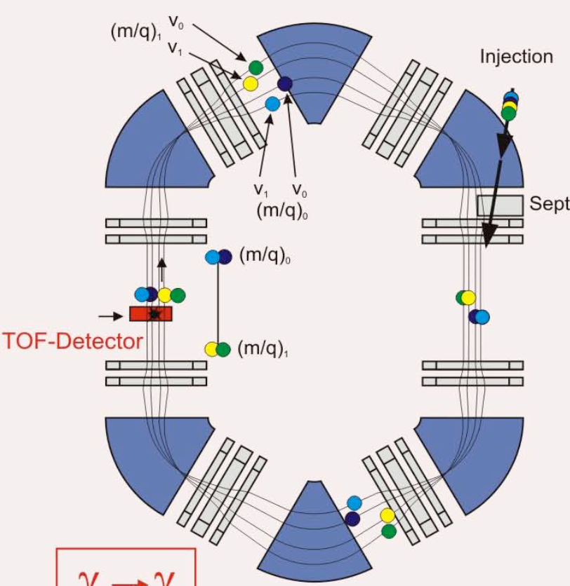
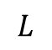
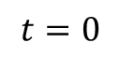
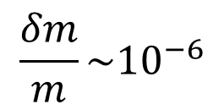
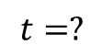
How to measure masses?
$$L$$
Time of flight mass spectrometry
Measure the time that an ion at known energy will travel a known distance.
Can be linear
Space limitation
Storage rings better
Distance unlimited
Best precision:
$$t=0$$
$$t=?$$
$$\frac{δm}{m}\sim {10}^{−6}$$

Slide 16

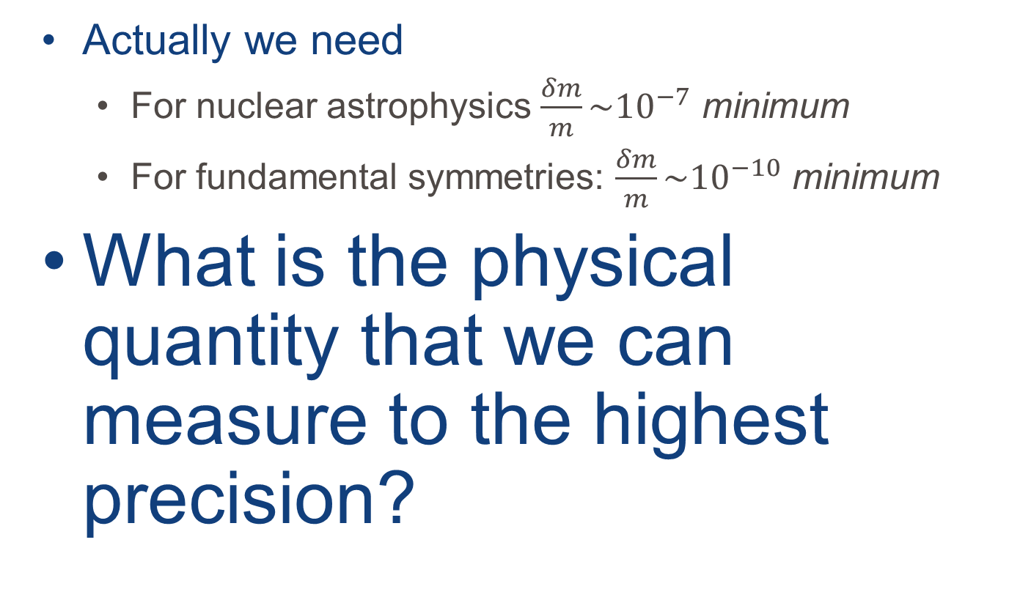
We can do better than ${δm}/m\sim 10^{−6}$
Actually we need
For nuclear astrophysics $\frac{δm}{m}\sim {10}^{−7}$ minimum
For fundamental symmetries: $\frac{δm}{m}\sim {10}^{−10}$ minimum
What is the physical quantity that we can measure to the highest precision?

Slide 17
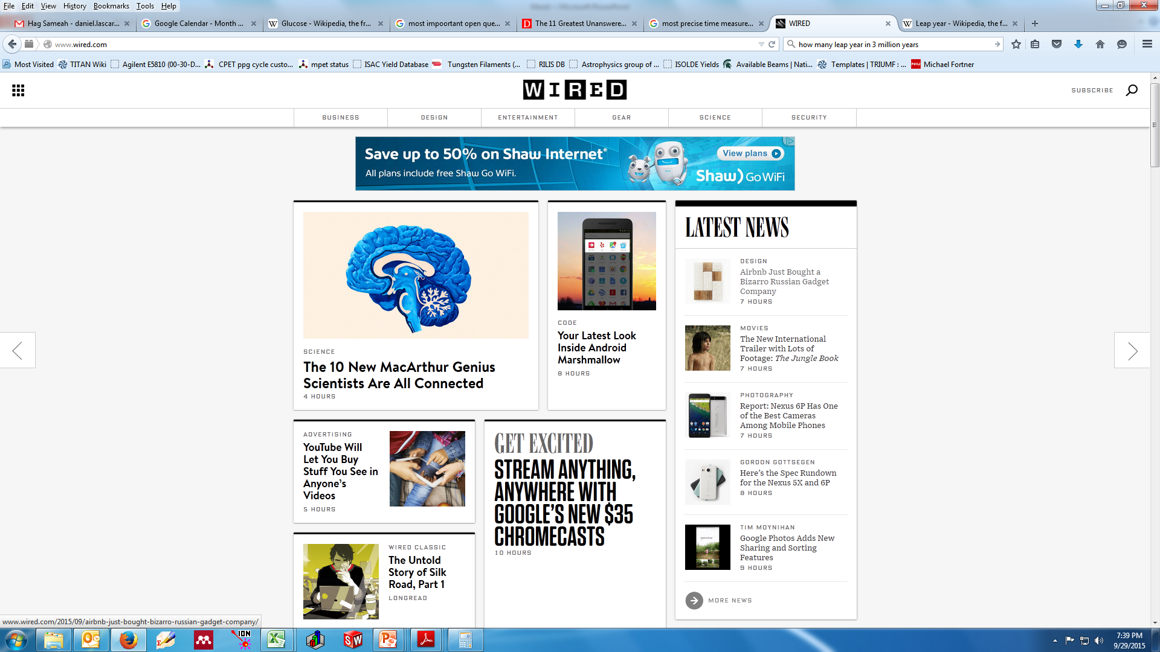
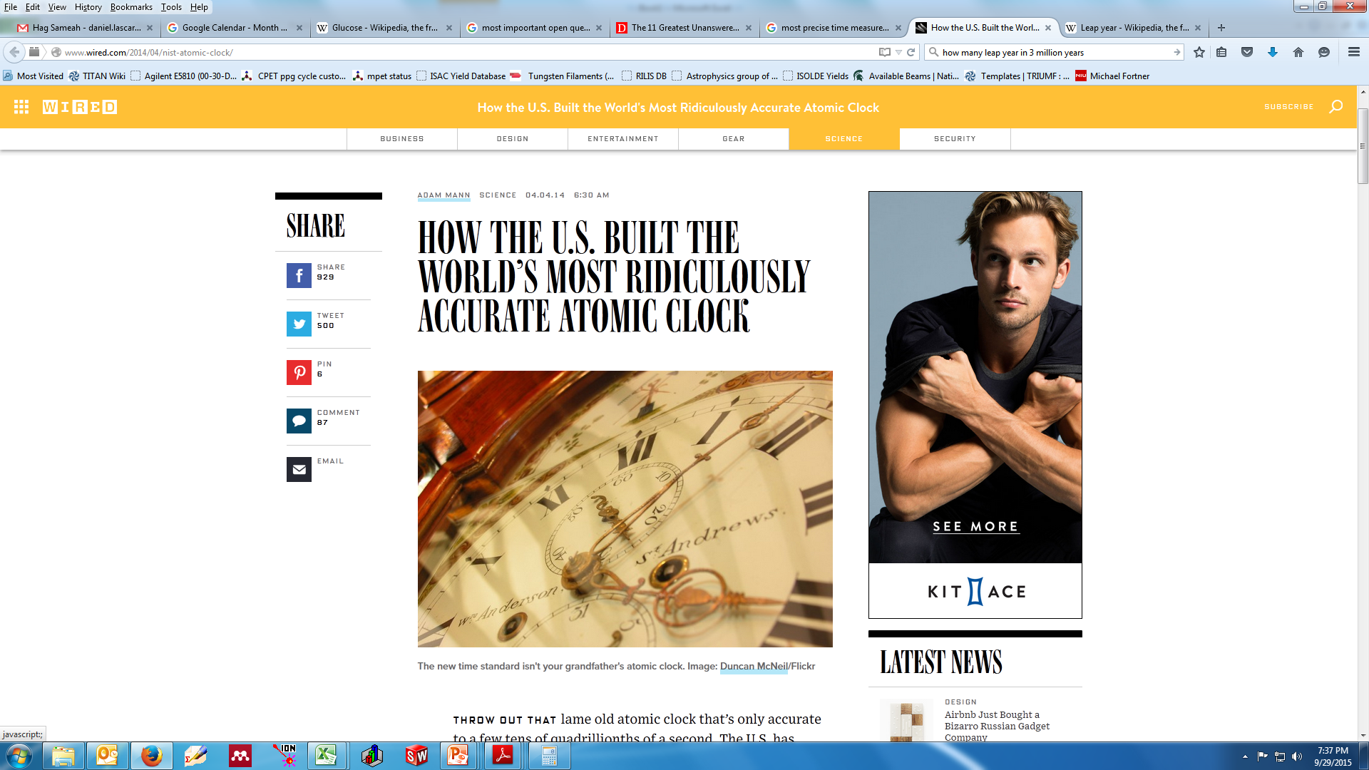
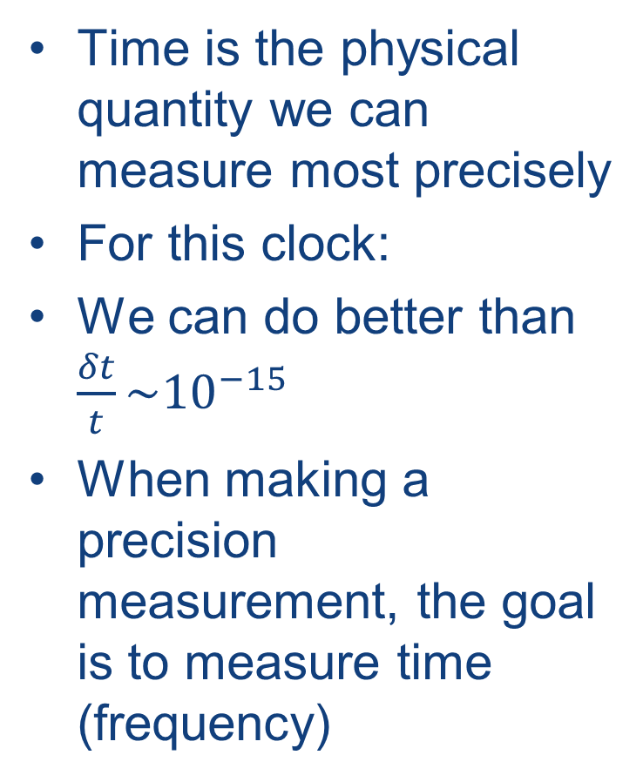
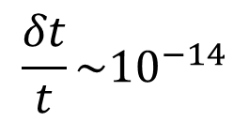
Time
Time is the physical quantity we can measure most precisely
For this clock:
We can do better than $\frac{δt}{t}\sim {10}^{−15}$
When making a precision measurement, the goal is to measure time (frequency)
$$\frac{δt}{t}\sim {10}^{−14}$$
For next class:
How can you relate a time (frequency) measurement to mass?
Notes:
1 second in 3 billion years

Slide 18
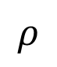
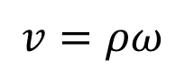
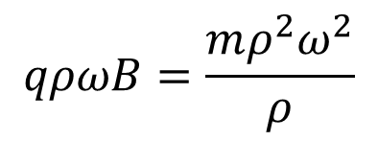
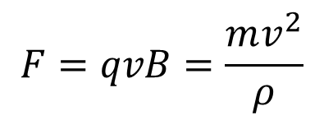
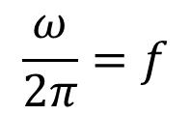
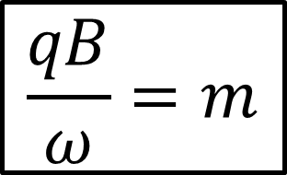
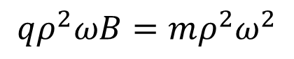
How do you relate time to mass?
Put it in a magnetic field
Long enough that it can complete multiple orbits.
$$F=qvB=\frac{mv^{2}}{ρ}$$
x x x x x x x x x x x x
+
x x x x x x x x x x x x
x x x x x x x x x x x x
$$\frac{ω}{2π}=f$$
x x x x x x x x x x x x
$$ρ$$
x x x x x x x x x x x x
x x x x x x x x x x x x
$$v=ρω$$
x x x x x x x x x x x x
$$qρωB=\frac{mρ^{2}ω^{2}}{ρ}$$
$$\frac{qB}{ω}=m$$
$$qρ^{2}ωB=mρ^{2}ω^{2}$$

Slide 19
How do you relate time to mass?
Put it in a magnetic field
Long enough that it can complete multiple orbits.
Can’t come in perpendicularly
Radius is a function of initial energy but you’ll never do better than a semicircle
How to get a full orbit?
x x x x x x x x x x x x
x x x x x x x x x x x x
x x x x x x x x x x x x
x x x x x x x x x x x x
x x x x x x x x x x x x
x x x x x x x x x x x x
x x x x x x x x x x x x
+

Slide 20
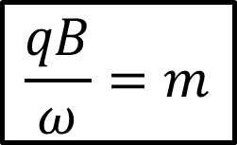
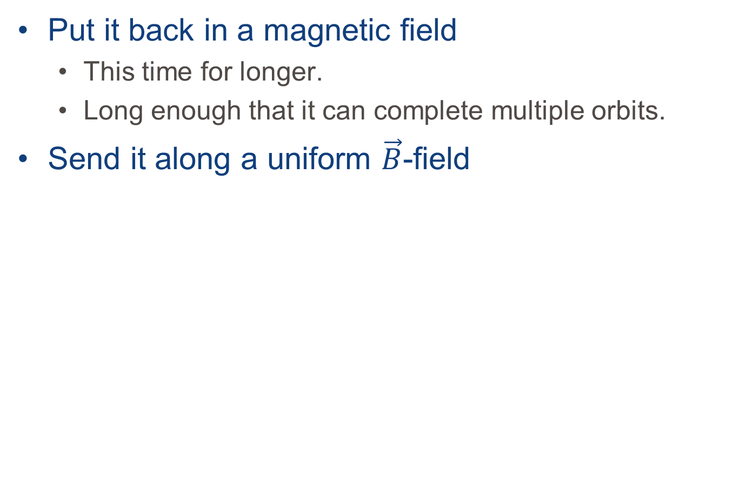
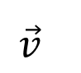
How do you relate time to mass?
$$\frac{qB}{ω}=m$$
Put it back in a magnetic field
This time for longer.
Long enough that it can complete multiple orbits.
Send it along a uniform $\vec{B}$-field
x x x x x x x x x x x x
+
x x x x x x x x x x x x
x x x x x x x x x x x x
Any perpendicular component will induce an oscillation
x x x x x x x x x x x x
x x x x x x x x x x x x
x x x x x x x x x x x x
x x x x x x x x x x x x
$$\vec{v}$$
+

Slide 21
What about the axial direction?
$$\frac{qB}{ω}=m$$
The ion will keep moving along.
Doesn’t give us much time to study it.
What should we do?
x x x x x x x x x x x x
+
x x x x x x x x x x x x
x x x x x x x x x x x x
x x x x x x x x x x x x
x x x x x x x x x x x x
x x x x x x x x x x x x
x x x x x x x x x x x x
+

Slide 22
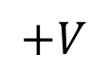
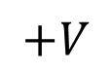
What about the axial direction?
$$\frac{qB}{ω}=m$$
Create a potential well.
All you need are a few electrodes
x x x x x x x x x x x x
+
x x x x x x x x x x x x
x x x x x x x x x x x x
x x x x x x x x x x x x
x x x x x x x x x x x x
x x x x x x x x x x x x
x x x x x x x x x x x x
$$+V$$
$$+V$$
+

Slide 23
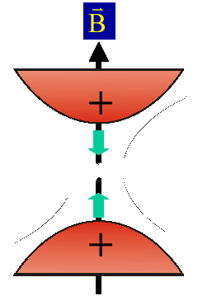



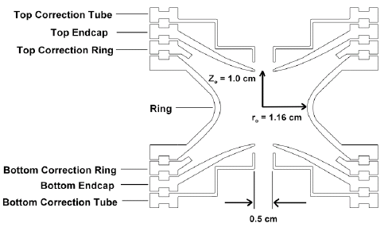
A Penning Trap
Electrodes create an axial quadrupole trapping potential
The potential repels in the radial direction but B takes care of that
Quadrupole potential created by making the electrodes conform to 2 hyperboloids of revolution.
Notes:
Point out that potential repels in the radial direction. It’s important later next slide.
Plus correction electrodes to account for finite extent of the hyperboloids and for the apertures.
Explain what a quadrupole potential is.
X² potential.
Simple harmonic oscillator
We know how to solve it

Slide 24
Trapping ions
$$\frac{qB}{ω}=m$$
x x x x x x x x x x x x
+
x x x x x x x x x x x x
x x x x x x x x x x x x
x x x x x x x x x x x x
x x x x x x x x x x x x
x x x x x x x x x x x x
x x x x x x x x x x x x
$$+V$$
$$+V$$
+
+

Slide 25
Trapping ions
$$\frac{qB}{ω}=m$$
Ions are trapped in 3 dimensions
Now you can study them
x x x x x x x x x x x x
+
x x x x x x x x x x x x
x x x x x x x x x x x x
x x x x x x x x x x x x
x x x x x x x x x x x x
x x x x x x x x x x x x
x x x x x x x x x x x x
$$+V$$
$$+V$$
+

Slide 26





Penning trap
Cyclotron frequency:
Superposition of
strong magnetic field
weak electrostatic quadrupole field
Motion of ions well understood:
Three Eigenmotions can be coupled using RF
Allows us to manipulate motion:
transfer from one motion into the other
$ν_{−}∼1$ kHz
$ν_{+}∼ν_{c}∼1$ MHz
Notes:
Time is the physical quantity we can measure most precisely.
Talk about decoupling of eigenmotions
$ν_{−}$ weakly mass dependent
$ν_{+}$ strongly mass dependent

Slide 27
Dipole and quadrupole excitations
DIPOLE EXCITATIONS
QUADRUPOLE EXCITATIONS

Slide 28
Energy Conversion
TOF
Detection
Linear
Energy
Magnetic field lines outside the Penning trap
Orbital
Energy
ω_{c} Excitation
Ions from the Penning trap
Notes:
We measure the energy by measuring the time of flight from the PT to a channeltron detector above the trap and outside of the magnetic field.
We need to know how much energy we’ve put into the system so we need to convert the orbital energy to linear energy.

Slide 29


Sample ToF spectrum
¹³³Cs
Time of Flight (arb units)
Unknown:
f_{c}=663,104.706(3) Hz (560 eV/c²)
Frequency (kHz)
Slide courtesy of J. Van Schelt
Notes:
133Cs was chosen because it is close in mass to what we were measuring and because it’s precision is dm/m = 1.7 E-10.
Click early: trf is the amount of time that the excitation has been applied for

Slide 30
Sample ToF Spectrum
¹³³Cs
Time of Flight (arb units)
For 1 s excitation, Width ~1Hz = Δν
Δm ≈ 200 keV/c²
Unknown:
f_{c}=663,104.706(3) Hz (560 eV/c²)
Frequency (kHz)
Slide courtesy of J. Van Schelt
Notes:
133Cs was chosen because it is close in mass to what we were measuring and because it’s precision is dm/m = 1.7 E-10.
Click early: trf is the amount of time that the excitation has been applied for

Slide 31


Slide 32


Slide 33

ISAC-II
ISAC-I
Cyclotron

Slide 34

ISAC-I
TITAN

Slide 35


Slide 36


Slide 37

The TITAN facility
BNG: fast m/q selection
MPET: mass measurement via cyclotron frequency determination
RFQ: Accumulation, cooling, and bunching
EBIT: ms charge breeding
Notes:
Going to a higher charge state is particularly important for TITAN because of…next slide

Slide 38




Linear Paul Trap
The TITAN RFQ
Slide courtesy of T. Brunner
10 mm
Necessary ingredients
250 kHz to 1 MHz RF along the electrodes
Axial DC gradient
Buffer gas cooling on the order of a few ms
(mm)
Similar to TITAN RFQ
NIMA 676 (2012) 32
Radial trajectory of ¹³³Cs in 2.5 x 10⁻² mbar
Viscous drag model calculation

Slide 39

Improving Precision
What can we do to improve mass precision?
Get a stronger magnet$\left(B\right)$
Measure for longer${(t}_{\text{rf}})$
Get more statistics $\left(N\right)$
Measure a smaller mass $\left(m\right)$
Measure higher charge state $\left(q\right)$
Expensive
What if the species is short lived?
Not normally an option

Slide 40

The TITAN facility
BNG: fast m/q selection
MPET: mass measurement via cyclotron frequency determination
RFQ: Accumulation, cooling, and bunching
EBIT: ms charge breeding
$$\frac{δm}{m}∝\frac{m}{t_{\text{rf}}qB\sqrt{N}}$$
Notes:
Going to a higher charge state is particularly important for TITAN because of…next slide

Slide 41



Electron Beam Ion Trap
Superconducting magnet, Helmholtz configuration, ≤ 6 T
Design limits on electron beam 70 keV & 5 A
7 radial ports with recessed Be windows
$$B=\frac{μ_{0}I}{2πr}$$
cathode
Sikler lens
electron gun
500 mA achieved
A. Lapierre et al., NIMA 624 (2010) 54
Notes:
6 T

Slide 42
Short Measurement Times
TITAN specializes in short measurement cycles.
Measure masses of some of the shortest lived nuclides ever.
³¹Na (t_{1/2} = 17 ms)
³²Na (t_{1/2} = 13 ms)
¹¹Li (t_{1/2} = 9 ms)
³¹Na⁺
T_{1/2} = 17 ms
ν_{c} = qe/m ∙ B/2π
³²Na⁺
T_{1/2} = 13 ms
Notes:
Tests have shown that we can go get to high precision with a 5ms excitation time
$δ_{\text{Na}}=30$ keV. $δ_{\text{Li}}=64$ keV

Slide 43



S1466 & S1502
10 days
Some of the cleanest beam from IGLIS
Measured masses of 18 states:
^{125,125m,126,127,127m}Cd
^{125,125m,126,126m,127,127m}In ^{128,128m,129,129m}In ^{130,130m1,130m2}In
PRL & PRC in prep
^{127,m}Cd
¹²⁷Cd
^{127m}Cd
Preliminary
Preliminary
Notes:
In all cases where we observed isomers, we observed the g.s. in the same spectrum

Slide 44

1.707(15) MeV isomer offscreen
Conflated States
Notes:
CPT measured ¹³⁰In (and reported conflated states) but is seems clear that the conflated states reported wasn’t the ground state.
Still, TITAN is doing the same because NUBASE reports a 50 keV isomer and we didn’t see it either

Slide 45

The Atomic Mass Evaluation

Slide 46

July 2016: S1466 & S1502
10 days
Some of the cleanest beam from IGLIS
Measured masses of 18 states:
^{125,125m,126,127,127m}Cd
^{125,125m,126,126m,127,127m}In ^{128,128m,129,129m}In ^{130,130m1,130m2}In
Will yield 2 pubs. min.
Misidentified isomer
Notes:
Good agreement in most cases.
Note that this is from the 2012 AME
It looks like JYFLTRAP misidentified the g.s. and measured the isomer so the isomer is what is listed in the AME

Slide 47

JYFLTRAP Data

Slide 48


Mass Measurements
Analysis of July Cd data is complete
Values are included in the 2016AME (just published)
Able to resolve more isomers than ever before
PRL should be submitted before the end of the month
Notes:
Looked at the isomers with respect to calculations from the NuShellX shell model code using the jj45 interaction which is the only one available for this mass region.

Slide 49



Thank you!
Merci!
Giessen
C. Andreoiu, J.C. Bale, B.R. Barquest, T. Brunner, U. Chowdhury, A. Finlay, D. Frekers, A.T. Gallant, G. Gwinner, R. Klawitter, B. Kootte, A.A. Kwiatkowski, D. Lascar, K.G. Leach, A. Lennarz, E. Leistenschneider, D.A. Short, J. Dilling (C. Babcock, P. Reiter & Y. Lan not pictured) and the TITAN Collaboration

Slide 50
July 2016: S1466 & S1502
10 days
Some of the cleanest beam from IGLIS
Measured masses of 18 states:
^{125,125m,126,127,127m}Cd
^{125,125m,126,126m,127,127m}In ^{128,128m,129,129m}In ^{130,130m1,130m2}In
Will yield 2 pubs. min.

Slide 51

Gas stopper cell
Slide courtesy of T. Brunner
Design of cryogenic gas catcher for the Super-FRS @ FAIR
From http://www.euroschoolonexoticbeams.be/site/files/2013_05_ExoBeams13_PThirolf_GasCell.pdf
He gas at 0.1-1bar
0.6mm
4 electrodes/mm
RF-carpet of cryogenic stopper
EPL, 96 (2011) 52001
Ions
RF-funnel
For ion extraction
Exit hole
DC cage
electrodes
RF carpet
Degrader/
Entrance windows
Inner chamber at ~60-70K
Vacuum chamber for
Insulating vacuum
Gas stopper cells used at fragmentation facilities to stop RI-beams (GSI/FAIR, FRIB, RIKEN, KUL Leuven, CARIBU @ ANL, …)
Extraction efficiencies of >10% have been observed
Extraction times on the order of 10ms
Up to 10³ ions/s space charge effects negligible; at higher ion intensities reduced transmission efficiency due to space-charge effects
Extreme pure gas required to reduce charge exchange and neutralization in the gas

Slide 52


RF funnel concept
Slide courtesy of T. Brunner
RF-funnel concept for Ba-tagging:
Converging-diverging nozzle
2 Stacks total 301 electrodes
RF-field applied to electrodes
P_{A} = 10 bar, P_{B} = 1 mbar
RF carpet
To LPT
Stopper cell
VRF = 120 V, f = 10 MHz
Simulated Ba⁺ transmission ~95%
VRF = 25V, f = 2.6 MHz
Simulated Ba⁺ transmission ~72%
Possible to extract ions from 10 bar Xe → initial design (and Ba-tagging design) by V. Varentsov for ion extraction from 0.1-1bar He
Optimization of design by V. Varetsov at GSI-FAIR
Extraction times O(10ms)
Int. J. Mass Spec. 379, 110 (2015)

Slide 53



MR-TOF-MS
Slide courtesy of T. Brunner
IJMS 349 (2013) 123
Multi-reflection time-of-flight mass spectrometer based on Greifswald/ISOLDE design
Can be operated in beam cleaning mode (δm/m ∼ 10⁻⁴) or mass-measurement mode (δm/m > 10⁻⁵)
Resolution limited by dispersion of MR TOF

Slide 54
Penning trap
Cyclotron frequency:
Superposition of
strong magnetic field
weak electrostatic quadrupole field
Motion of ions well understood:
Three Eigenmotions can be coupled using RF
Allows us to manipulate motion:
transfer from one motion into the other
$ν_{−}∼1$ kHz
δm/m > 10⁻⁷
Half lives below 10ms measured at TITAN
$ν_{+}∼ν_{c}∼1$ MHz
Notes:
Talk about decoupling of eigenmotions
$ν_{−}$ weakly mass dependent
$ν_{+}$ strongly mass dependent

Slide 55




Status of EMMA Ion Optical Elements

Slide 56


The rp-process
Waiting Points require nuclear masses
2p channel daughters have never been measured
Example: ⁶⁸Se(p,$γ$)(p,$γ$)⁷⁰Kr
Specifically mentioned by rp-process theorists
H. Schatz, IJMS, 349–350 1 (2013)
ISAC yields
⁷²Kr: 440/s (measured)
⁷⁰Kr: ~0.2/s extrapolated assuming yield reduction of 50/n
→ Impossible to produce at ISAC
→ Possible production at EMMA

Slide 57





The rp-process case ⁷⁰Kr
Rb
Kr
Br
Se
As
Ge
Ga
Zn
Cu
Ni
Co
³⁸K + ⁴⁰Ca
200 MeV
$$σ\text{ (}\text{mb}\text{)}$$
$$25<σ$$
⁷⁰Kr
$$5<σ<25$$
$$0.1<σ<5$$
$$σ<0.1$$
→ Impossible to produce at ISAC
ISAC yields
⁷²Kr: 440/s (measured)
⁷⁰Kr: ~0.2/s extrapolated assuming yield reduction of 50/n
Z
Possible production and separation at EMMA
N
Notes:
5.2 MeV/U

Slide 58

The rp-process case ⁷⁰Kr
³⁵Ar + ⁴⁰Ca
100 MeV
$$σ\text{ (}\text{mb}\text{)}$$
$$25<σ$$
Sr
Rb
Kr
Br
Se
As
Ge
Ga
$$5<σ<25$$
$$0.1<σ<5$$
⁷⁰Kr
$$σ<0.1$$
→ Impossible to produce at ISAC
ISAC yields
⁷²Kr: 440/s (measured)
⁷⁰Kr: ~0.2/s extrapolated assuming yield reduction of 50/n
Z
Possible production and separation at EMMA
N
Notes:
³⁵Ar Production = $6.5×{10}^{6}$/s with Ti target @ 70uA of proton current
70Kr cross section = 0.0457 mb

Slide 59

Stellar reaction rates
Paper details a list of more than 1,000 nuclei that contribute to asymmetric reaction rates in:
$\left(α,γ\right)$
$\left(p,γ\right)$
$\left(γ,n\right)$
$\left(p,n\right)$
$\left(α,n\right)$
$\left(α,p\right)$
Most are neutron-deficient
This is a goldmine of astrophysical motivation

Slide 60

Nuclear structure – ¹⁰⁰Sn
Two production mechanisms:
⁵⁰Cr + ⁵⁸Ni
Chartier et al, PRL 77 12 (1996)
^{124/3}Xe Fragmentation
Hinke et al, Nature 486 7403 (2012)
N=Z
rp-process
r-process path
Structural Changes
Position of the dripline
Haloes –
Continuum Structure

Slide 61

What is the pressure in MPET?
Slide courtesy of E. Leistenschneider
Notes:
Particle in a cell simulation:
Individual particle tracking given system geometry
Collisions following Knudsen`s law
Material outgassing is main source of gas, others can also be included
"Calibrated" using actual measurements from IGs

Slide 62



What pressure is required?
$$P=\frac{N_{ev}k_{B}T}{σs}$$
10⁻¹¹ torr
HCI $ε=90\%$
10⁻¹² torr
HCI $ε=99\%$
Slide courtesy of E. Leistenschneider

Slide 63

Solution: Cryogenically cool the trap
Need to reduce pressure by factor of 300
Slide courtesy of E. Leistenschneider

Slide 64

Cryocooler

Slide 65

Rebuild/redesign the Penning trap
Notes:
New electrodes to allow for cryopumping on the surface
RF to be applied at ring rather than guard/correction electrodes

Slide 66


Transport System
Gas filled RFQ’s
Carbon filled PPS rods for axial DC field
RFQ Switchyard
Radial confinement through RF
Axial control through DC gradient
Slide courtesy of P. Reiter
Notes:
PPS = Polyphenylene Sulphide

Slide 67

Analyzer
Based on AMBIPROBE @ JLU used for analytic mass spectrometry
Two gridless, electrostatic ion mirrors
Injection & ejections through pulsed endcaps
Slide courtesy of P. Reiter
Notes:
PPS = Polyphenylene Sulphide

Slide 68



Commissioning in mass separator mode
¹³³Cs Charged Residual Air Particles from a hot cathode ion gauge
Slide courtesy of P. Reiter
Notes:
C.R.A.P. = Charged Residual Air Particles

Slide 69

Commissioning in mass separator mode
¹³³Cs Charged Residual Air Particles from a hot cathode ion gauge
Adjust retrapping time to capture Cs
Slide courtesy of P. Reiter
Notes:
C.R.A.P. = Charged Residual Air Particles

Slide 70

So we wait for a β-decay
Stability
Some possible r-process paths
[A. Champagne, RIA Summer School 06]
The S_{n} where equilibrium occurs depends only on T and n_{n}
Notes:
This process isn’t a single line. Many assumptions go into each model, even T and n_n have a range of possibilities
Note the path density at the closed shells.
N=50,82,126 → A=82,130,195

Slide 71

Explosive nucleosynthesis
Fe Peak
Notes:
Most A>56 nuclei produced in explosive processes.

Slide 72


Neutron Separation Energy - $S_{n}$
Preliminary
Notes:
S_{n} is ugly because of odd-even pairing effects. Note the inversion when we switch from Cd and In. Because it’s ugly…

Slide 73


(2)Neutron Separation Energy - $S_{2n}$
In
Z=49
Preliminary
Cd
Z=48
Notes:
Here we see that in most cases calculated S_{n} our g.s. measurements agree with the AME values though in many cases we’re able to bring values town to the order of 10keV

Slide 74

The TITAN MR-ToF
Standard MR-ToF isobar separator:
Separation based on conversion of time in spatial spread by Bradbury-Nielsen Gate
Not possible due to space constraints
Novel MR-ToF Isobar Separator
Separation based mass-selective retrapping
Bunching, cooling & retrapping in the same trap
Compact system
Slide courtesy of P. Reiter

Slide 75

Mass selective re-trapping
Slide courtesy of P. Reiter

Slide 76

Analyzer performance – May 2016
Goal Achieved
Slide courtesy of D. Short
Notes:
This is in mass measurement mode where the ions are sent to an MCP at the end of the analyzer.
To select masses, they have to be selectively retrapped for transport down the RFQ. Current best $R≈16k$

Slide 77

Current
MR-ToF works for broad range of masses (Aug 2016)

Slide 78

TITAN MR-TOF vs GSI MR-TOF
Comparison to the gold standard for MR-TOF’s with ¹³³Cs
Notes:
GSI MR-TOF
Larger analyzer → not a fair comparison
Compare resolving power vs. Time-of-flight

Slide 79

Commissioning in mass separator mode
R ~ 1.6 x 10⁴ after 3.7 ms
Slide courtesy of P. Reiter
Notes:
C.R.A.P. = Charged Residual Air Particles

Slide 80

TITAN MR-TOF Re-Trapping
Commissioning in mass separator mode
1 ST 128.5 MT → separation power ~ 25.000 at 5V re-trapping potential
1
MCP
Detector
2
MCP
Detector
Ion mirror 2
Ion mirror 2
N = 129.5 turns
N = 2 turns
Ion mirror 1
Ion mirror 1
RF Ion Trap
Slide courtesy of P. Reiter

